Slide 1

G2M Cab Case Study
Investing Recommendations
01-Sep-2023

Slide 2
Agenda
Problem Statement
Data and Assumptions
EDA
EDA Summary
Recommendations

Slide 3
Problem Statement
Objective:
To decide if Pink or Yellow Cab are a better investment.
To decide if the cab industry is a worthwhile investment.
Questions to be Answered:
Is there a correlation between trip distance and the profit?
Is the cab industry growing at a fast enough rate to beat inflation?
Do the businesses make a high enough profit margin to remain profitable?
Are the businesses scalable?
Do these businesses retain repeat customers?

Slide 4

Dataset and Assumptions
Dataset:
Timeframe of data: 2016-2018
Cab trips analysed: 359392
Data Used:
Cab Data
Assumptions:
The cities listed in the transactions are the only cities the companies operate in.
Number of users in cities includes other companies.
Factors such as fuel cost, car depreciation, and wages are included in cost of trip (profit is real profit).
Data is otherwise entered correctly.
Transactions
Cities
Customers

Slide 5
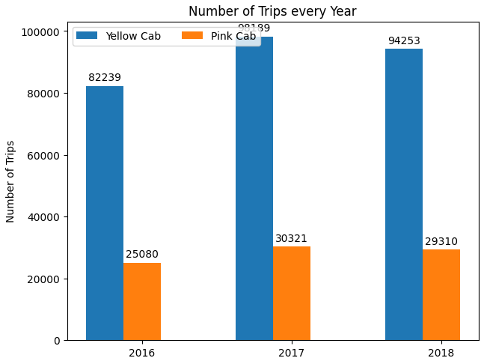
Number of Trips Per Year

Slide 6
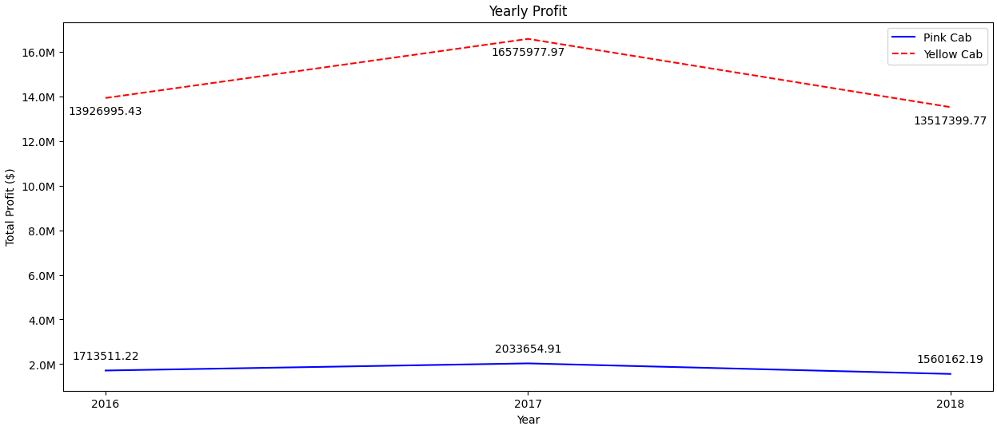
Yearly Profits

Slide 7
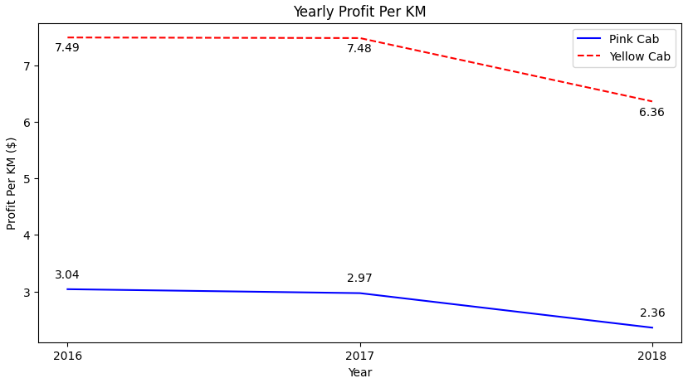
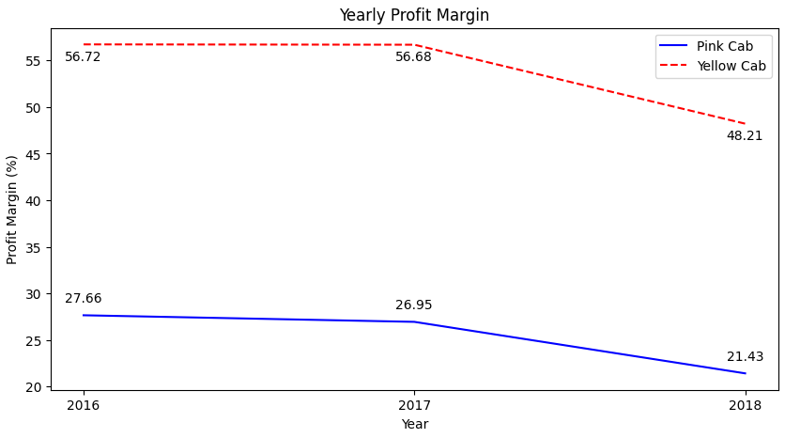
Margins and Profit/KM

Slide 8
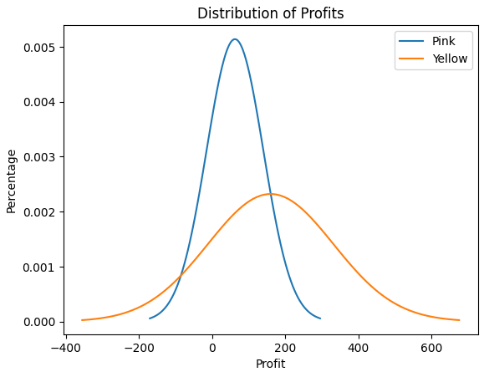
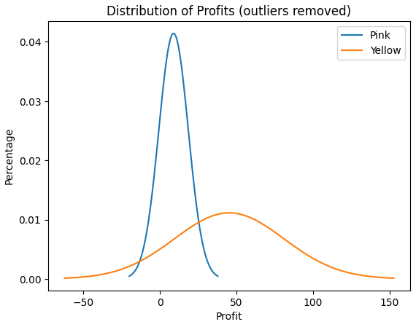
Distribution of Profits
Here we are assuming a normal distribution for profits.
Yellow: 82.41% of transactions give positive profit, mean profit of 160.26
Pink: 79% of transactions give positive profit, mean profit of 62.65
Accounting for outliers, the mean profit of Pink went down by 63% whereas for Yellow it went down by 42%.
Pink is more dependent on long journeys and outlier payments.

Slide 9
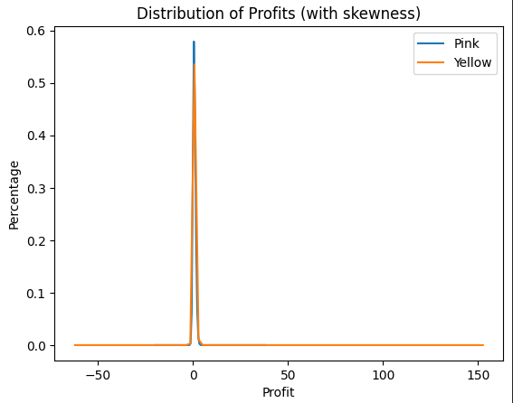
Distribution of Profits (with Skewness)
Distribution isn’t normal because companies are biased towards positive profit.
Therefore, mean should not be the same as median.

Slide 10
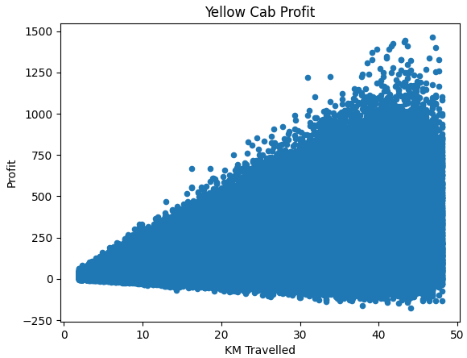
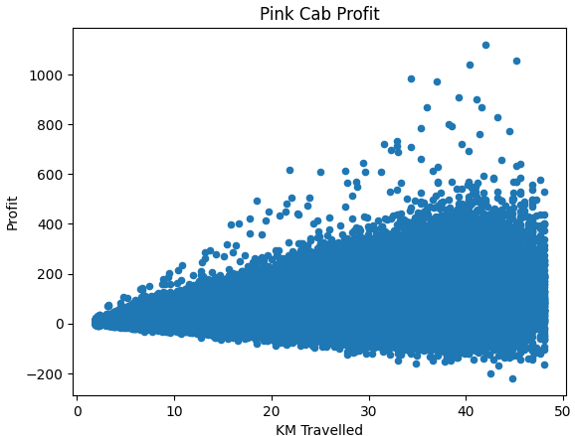
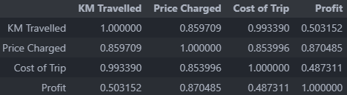
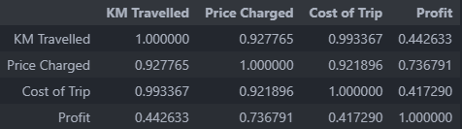
Correlative Analysis of Profits
Variance in profit increases by distance, including number of losses.
Suggest that shorter trips make more consistent income (around 5-10 KM)
Furthermore, shorter trips tend to be anecdotally better since it is easier to find customers inside the city.
Variance in the profit may in part be accounted from by duration of the trip.
Knowing the duration of trips and the downtime between trips would increase data analysis quality.

Slide 11
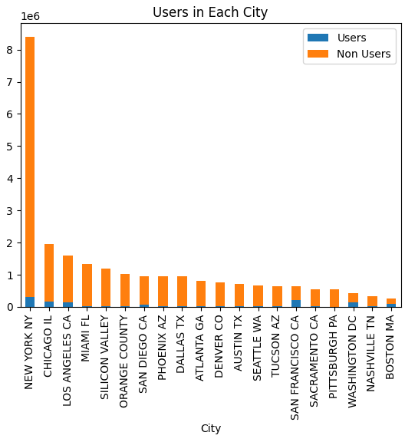
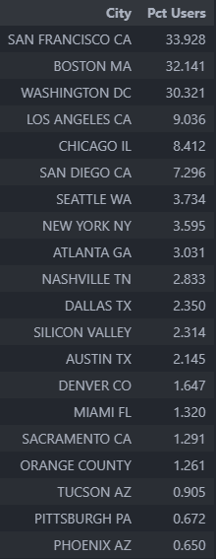
Marketshare of Users in Cities

Slide 12
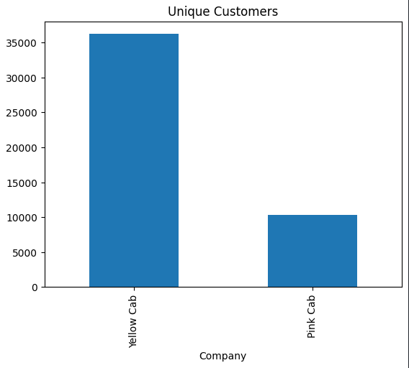

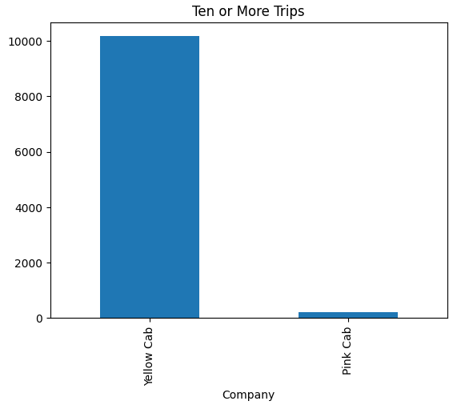
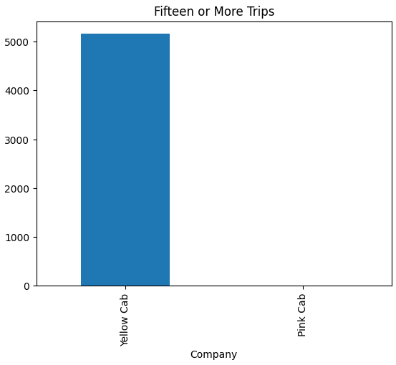
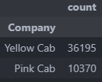
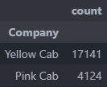
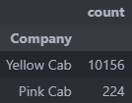
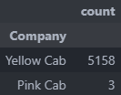
Customer Retention

Slide 13
Recommendations
Is there a correlation between KM travelled and the profit of the trip?
Yellow Cab has a correlation of 0.5 between profit and distance, while Pink Cab has 0.44. This suggests that there is a moderate correlation between the two.
This suggests that Yellow Cab might be charging a higher rate or are making more money from a waiting fee, since they are making more profit with larger distances. However, Yellow has a greater correlation between price charged and profit (0.87) as well as cost of trip and profit (0.48) compared to the correlations of Pink Cab (0.73 and 0.41 respectively).
This suggests that Yellow Cab has greater efficiency in generating more profit from the money they spend on trips. In both companies, there is the possibility of restructuring, and changing pricing to increase efficiency.
2. Is the cab industry growing at a fast enough rate to beat inflation?
According to data from IBISWorld, the revenue generated by the Taxi market in the US was $41.7bn in 2022, increasing by 12% from 2021.
The industry has grown by 1.5% per year on average since 2017; slower than the US economy, which grew 2.06% in 2022.
The market will likely grow at a greater rate than average over the next few years (for reasons such as more domestic holidays, higher fuel prices).
Because of inflation, the rising costs of running taxis due to fuel prices, and that both companies have had a small decrease in profit from 2017 to 2018 followed by a sharp decrease during COVID, there will likely cause short term instability in the industry.
In the long term, the taxi industry will continue to be a staple due to commuters and holidaymakers (for example, people are more likely to go on holidays when the economy is doing well and have excess spending money).

Slide 14
Recommendations
3. Do the businesses make a high enough profit margin to remain profitable?
Yellow Cab makes a profit margin of 48.21% compared to Pink Cab making 21.43%. Due to this, the margins of Yellow Cab are significantly better. This gives Yellow Cab a greater degree of security to endure the market's instability. Yellow Cab over triple the number of trips in 2018 compared to Pink Cab and their superior profit per kilometre ($6.36 compared to $2.36 in 2018), makes Yellow Cab both the safer and more profitable choice.
4. Are the businesses scalable?
The industry has a small percentage of users in some cities (New York with 3.6%). The industry has opportunity to grow, but the competition from cheaper services such as Uber is causing loss in market share and profits. Taxi drivers might be more trusted, since they are licensed and registered. Overall, it is difficult to say if the industry is scalable, but the businesses can be scaled by expanding to new cities, especially those with underdeveloped transport systems.
5. Do these businesses retain repeat customers?
In Pink Cab, of the 36k unique customers, 50% use the service over 5 times, 29% use it over 10 times, and 14% over time 15 times. In Yellow Cab, of the 10k unique customers, 41% use the service over 5 times, 2% over 10 times, and 0.03% over 15 times. Therefore, the retention of Pink cab is significantly better, suggesting a better brand image, greater trust, and more repeated business.
Final Recommendation: If choosing to invest, the Yellow Cab company is larger, safer, and more profitable

Slide 15

Thank You

